Slide 1
NBA Player Analytics - Dashboard Mockups
Team - D&A champs
Aug 8th, 2021

Slide 2
Dashboard:
Used Tableau as a visualization tool
As a selector, by selecting the Tier and Position from the dashboard, the selector gains the following insights about the players,
Top players for each of the stats (eg: 3P, ASST, BLK..)
The average score of each player across all the seasons for each of the stat
How players performed in each of the season for the selected stat
Players salary across each seasons
Players total points across each season
The dashboard has various screens to display the afore mentioned features

Slide 3
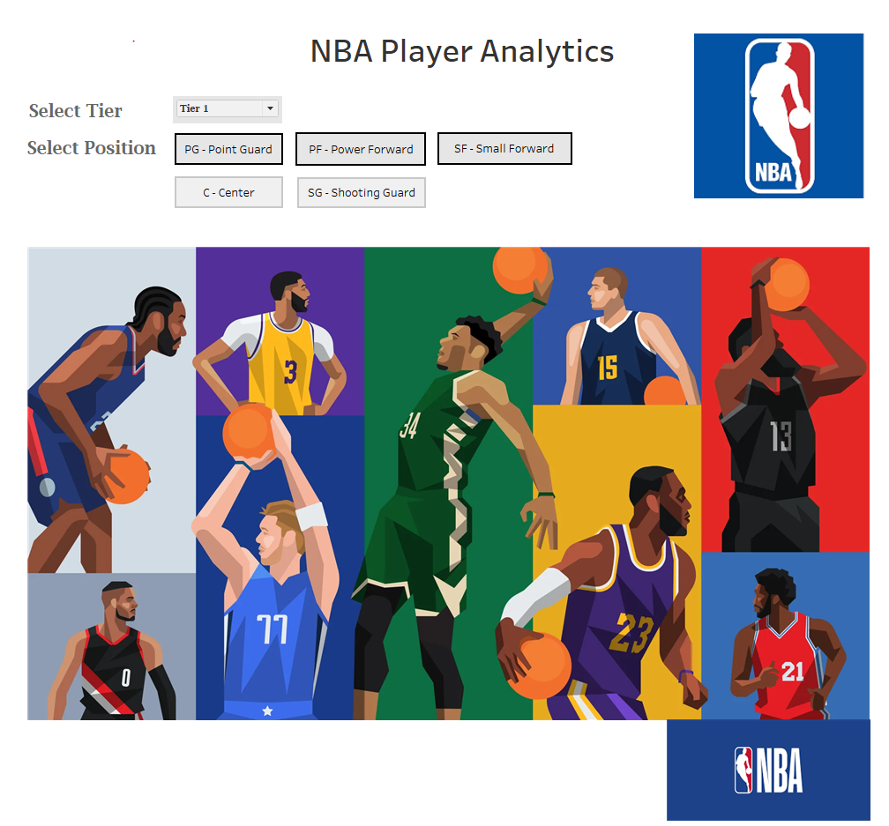
Dashboard Landing Page - Mockup
Selector selects the tier and the position

Slide 4
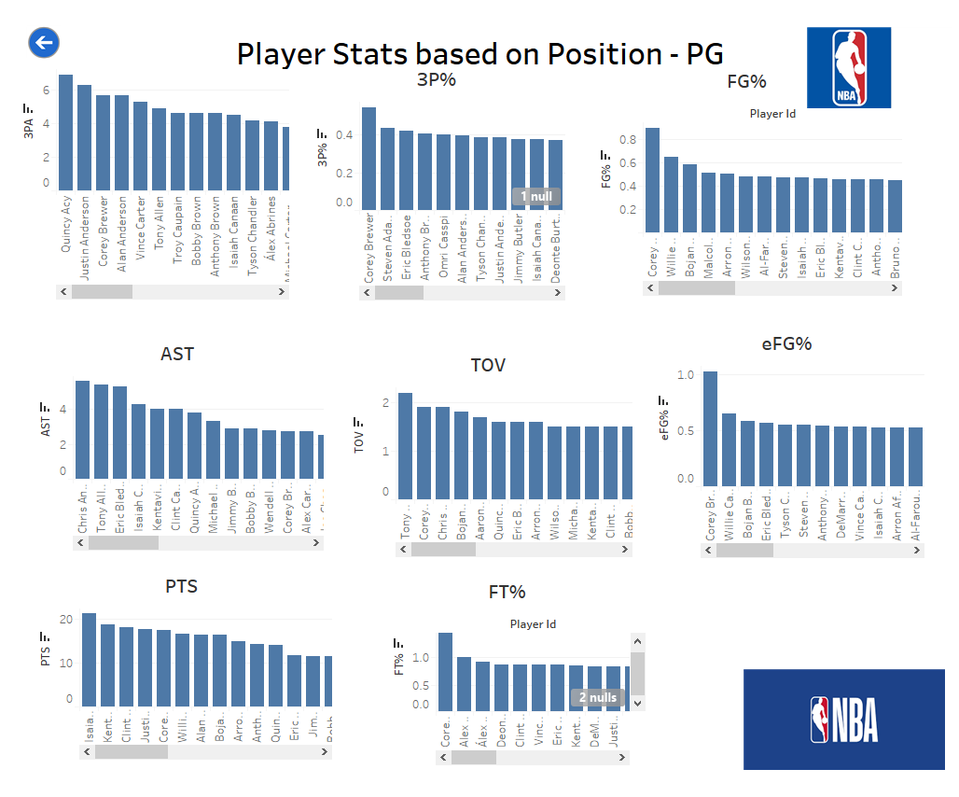
Player Stats Page - Mockup
Back button to go back to previous screen
Each player can be clicked to get further insights about the player, Control navigates to next screen

Slide 5
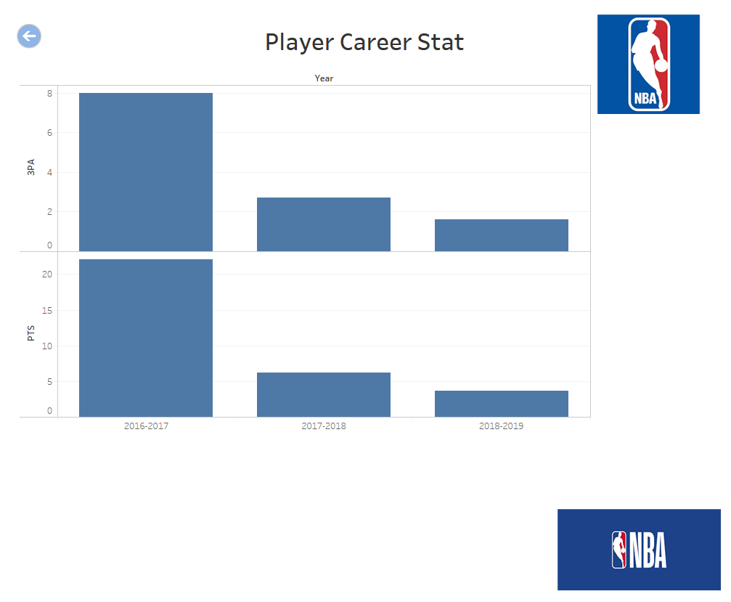
Player Career Stats Page - Mockup
Back button to go back to previous screen

